Slide 1
NLP

Slide 2
Introduction to NLP
Brief History of NLP

Slide 3
The Turing Test
Alan Turing: the Turing test
language as test for intelligence
Three participants
a computer and two humans (one is an interrogator)
Interrogator’s goal
to tell the machine and human apart
Machine’s goal
to fool the interrogator into believing that a person is responding
Other human’s goal
to help the interrogator reach his goal
Q: Please write me a sonnet on the topic of the Forth Bridge.
A: Count me out on this one. I never could write poetry.
Q: Add 34957 to 70764.
A: 105621 (after a pause)

Slide 4
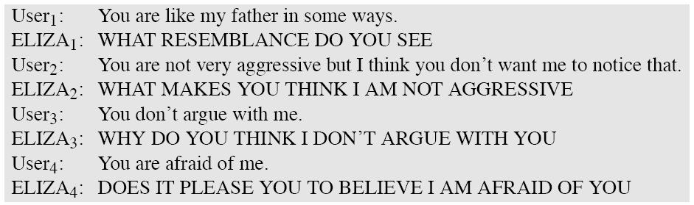
Eliza
Longer example here:
http://thoughtcatalog.com/oliver-miller/2012/08/a-conversation-with-eliza

Slide 5
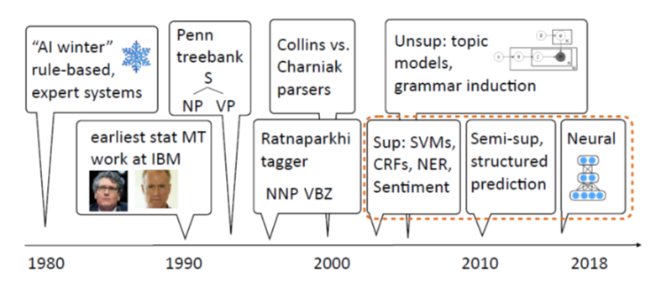
A Brief History of NLP
[Slide from Greg Durrett]

Slide 6
Some Brief History
Foundational insights (1940’s and 1950’s)
automaton (Turing)
probabilities
information theory (Shannon)
formal languages (Backus and Naur)
noisy channel and decoding (Shannon)
first systems (Davis et al., Bell Labs)
Two camps (1957-1970): symbolic and stochastic
Transformation Grammar (Harris, Chomsky)
Artificial Intelligence (Minsky, McCarthy, Shannon, Rochester)
automated theorem proving and problem solving (Newell and Simon)
Bayesian reasoning (Mosteller and Wallace)
Corpus work (Kučera and Francis)

Slide 7
Some Brief History
Four paradigms (1970-1983)
stochastic (IBM)
logic-based (Colmerauer, Pereira and Warren, Kay, Bresnan)
nlu (Winograd, Schank, Fillmore)
discourse modelling (Grosz and Sidner)
Empiricism and finite-state models redux (83-93)
Kaplan and Kay (phonology and morphology)
Church (syntax)
Late years (1994-2010)
integration of different techniques
different areas (including speech and IR)
probabilistic models
machine learning
structured prediction
topic models

Slide 8
The Most Recent Years
Machine learning methods
SVM, logistic regression (maxent), CRFs
Shared tasks
TREC, DUC, TAC, *SEM
Semantic tasks
RTE, SRL
Semi-supervised and unsupervised methods
Zero-shot learning, transfer learning
Deep Learning
Embeddings, LSTM, CNN, Attention, GANs, Transformers

Slide 9
Summarizing 30 years of ACL Discoveries Using Citing Sentences
1979 | Carbonell (1979) discusses inferring the meaning of new words.
1980 | Weischedel and Black (1980) discuss techniques for interacting with the linguist/developer to identify insufficiencies in the grammar.
1981 | Moore (1981) observed that determiners rarely have a direct correlation with the existential and universal quantifiers of first-order logic.
1982 | Heidorn (1982) provides a good summary of early work in weight-based analysis, as well as a weight-oriented approach to attachment decisions based on syntactic considerations only.
1983 | Grosz et al. (1983) proposed the centering model which is concerned with the interactions between the local coherence of discourse and the choices of referring expressions.
1984 | Karttunen (1984) provides examples of feature structures in which a negation operator might be useful.
1985 | Shieber (1985) proposes a more efficient approach to gaps in the PATR-II formalism, extending Earley’s algorithm by using restriction to do top-down filtering.
1986 | Kameyama (1986) proposed a fourth transition type, Center Establishment (EST), for utterances. e.g., in Bruno was the bully of the neighborhood.
1987 | Brennan et al. (1987) propose a default ordering on transitions which correlates with discourse coherence.
1988 | Whittaker and Stenton (1988) proposed rules for tracking initiative based on utterance types; for example, statements, proposals, and questions show initiative, while answers and acknowledgements do not.
1989 | Church and Hanks (1989) explored tile use of mutual information statistics in ranking co-occurrences within five-word windows.

Slide 10
Summarizing 30 years of ACL Discoveries Using Citing Sentences
1990 | Hindle (1990) classified nouns on the basis of co-occurring patterns of subject verb and verb-object pairs.
1991 | Gale and Church (1991) extract pairs of anchor words, such as numbers, proper nouns (organization, person, title), dates, and monetary information.
1992 | Pereira and Schabes (1992) establish that evaluation according to the bracketing accuracy and evaluation according to perplexity or cross entropy are very different.
1993 | Pereira et al. (1993) proposed a soft clustering scheme, in which membership of a word in a class is probabilistic.
1994 | Hearst (1994) presented two implemented segmentation algorithms based on term repetition, and compared the boundaries produced to the boundaries marked by at least 3 of 7 subjects, using information retrieval metrics.
1995 | Yarowsky (1995) describes a ’semi-unsupervised’ approach to the problem of sense disambiguation of words, also using a set of initial seeds, in this case a few high quality sense annotations.
1996 | Collins (1996) proposed a statistical parser which is based on probabilities of dependencies between head-words in the parse tree.
1997 | Collins (1997)’s parser and its re-implementation and extension by Bikel (2002) have by now been applied to a variety of languages: English (Collins, 1999), Czech (Collins et al., 1999), German (Dubey and Keller, 2003), Spanish (Cowan and Collins, 2005), French (Arun and Keller, 2005), Chinese (Bikel, 2002) and, according to Dan Bikels web page, Arabic.
1998 | Lin (1998) proposed a word similarity measure based on the distributional pattern of words which allows to construct a thesaurus using a parsed corpus.
1999 | Rapp (1999) proposed that in any language there is a correlation between the cooccurrences of words which are translations of each other.

Slide 11
Summarizing 30 years of ACL Discoveries Using Citing Sentences
2000 | Och and Ney (2000) introduce a NULL-alignment capability to HMM alignment models.
2001 | Yamada and Knight (2001) used a statistical parser trained using a Treebank in the source language to produce parse trees and proposed a tree to string model for alignment.
2002 | BLEU (Papineni et al., 2002) was devised to provide automatic evaluation of MT output.
2003 | Och (2003) developed a training procedure that incorporates various MT evaluation criteria in the training procedure of log-linear MT models.
2004 | Pang and Lee (2004) applied two different classifiers to perform sentiment annotation in two sequential steps: the first classifier separated subjective (sentiment-laden) texts from objective (neutral) ones and then they used the second classifier to classify the subjective texts into positive and negative.
2005 | Chiang (2005) introduces Hiero, a hierarchical phrase-based model for statistical machine translation.
2006 | Liu et al. (2006) experimented with tree-to-string translation models that utilize source side parse trees.
2007 | Goldwater and Grifﬁths (2007) employ a Bayesian approach to POS tagging and use sparse Dirichlet priors to minimize model size.
2008 | Huang (2008) improves the re-ranking work of Charniak and Johnson (2005) by re-ranking on packed forest, which could potentially incorporate exponential number of k-best list.
2009 | Mintz et al. (2009) uses Freebase to provide distant supervision for relation extraction.
2010 | Chiang (2010) proposes a method for learning to translate with both source and target syntax in the framework of a hierarchical phrase-based system.

Slide 12
Introduction to NLP
NACLO

Slide 13
NACLO and IOL
The North American Computational Linguistics Olympiad
Competition held since 2007 in the USA and Canada
http://www.nacloweb.org
Best individual US performers so far:
Adam Hesterberg (2007)
Rebecca Jacobs (2007-2009) – 3 team golds + 2 individual medals
Ben Sklaroff (2010)
Morris Alper (2011)
Alex Wade (2012, 2013) – 2 team golds + 2 individual golds + 1 individual silver
Tom McCoy (2013) – Yale grad
Darryl Wu (2012, 2014)
James Wedgwood (2015, 2016) – Yale junior
Brian Xiao (2017), Swapnil Garg (2018)
Other strong countries:
Russia, UK, Netherlands, Poland, Bulgaria, South Korea, Canada, China, Sweden
IOL – the International contest
Since 2003
2013 in the UK, 2014 in China, 2015 in Bulgaria, 2016 in India, 2017 in Ireland, 2018 in Czechia
http://www.ioling.org

Slide 14
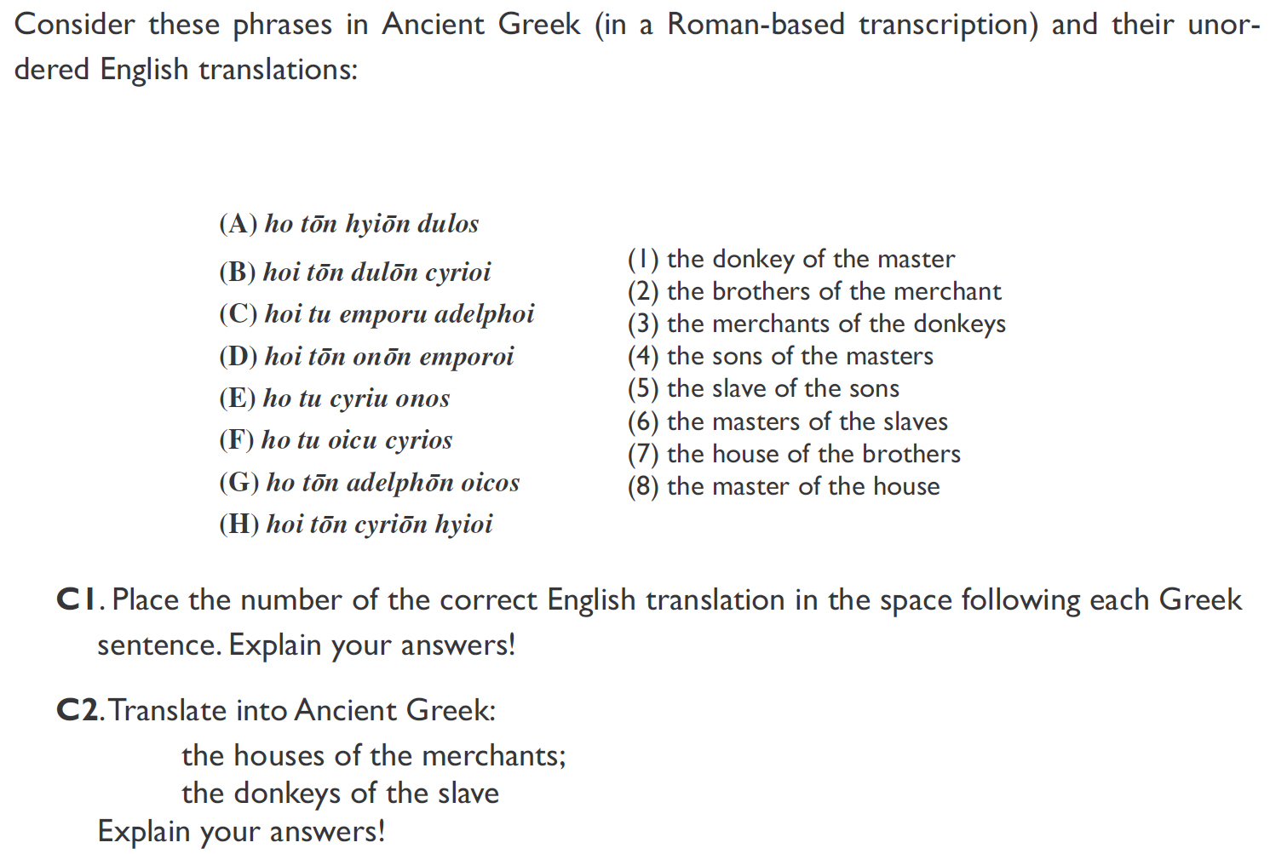
[A Donkey in Every House, by Todor Tchervenkov, NACLO 2007]

Slide 15
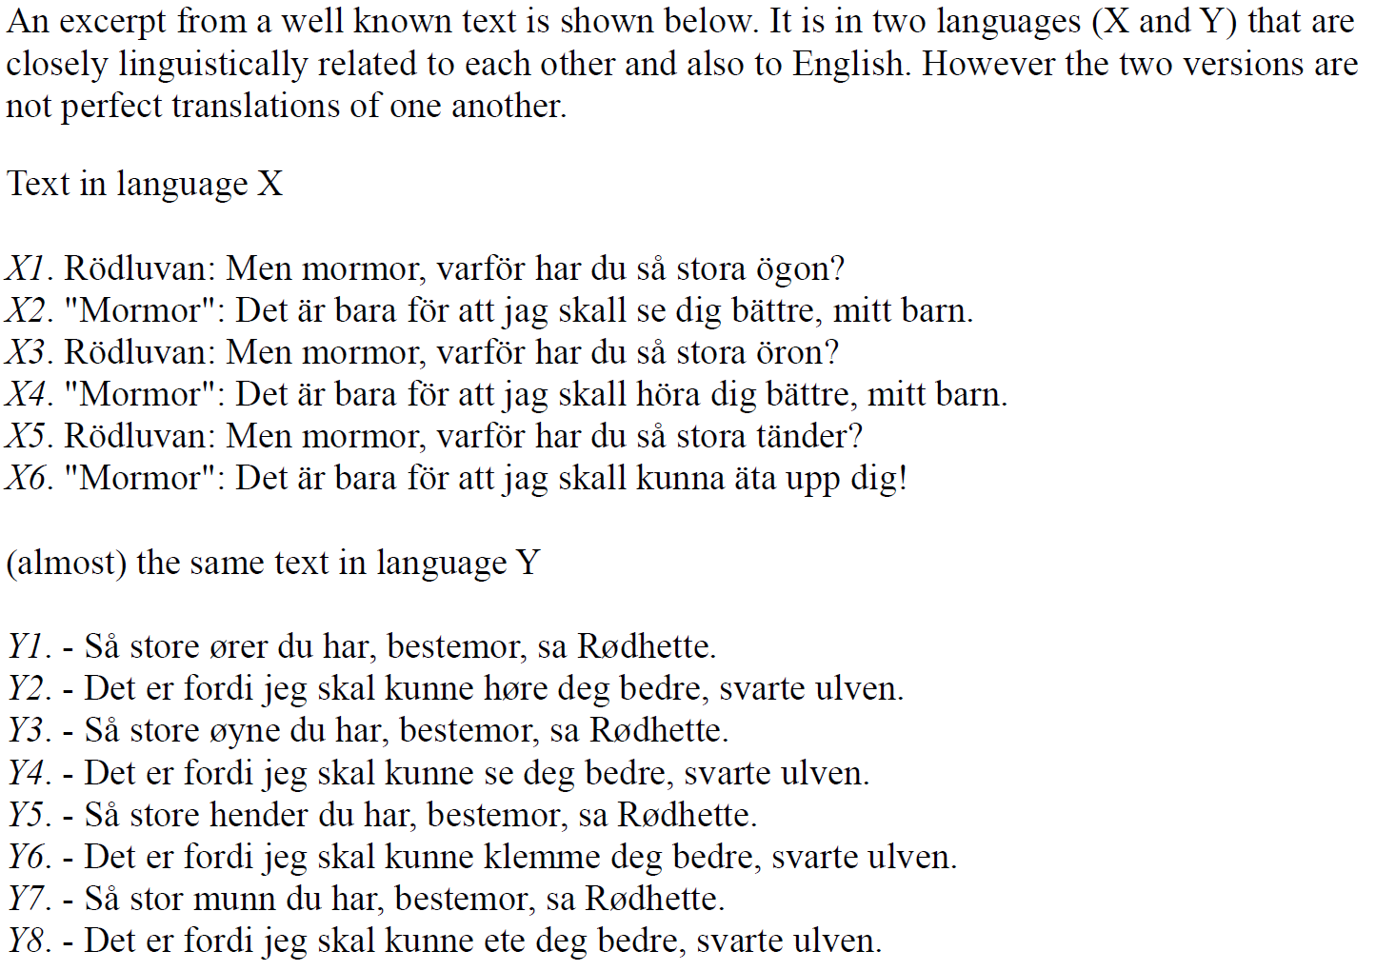
[Spare the Rod, by Dragomir Radev, NACLO 2008]

Slide 16
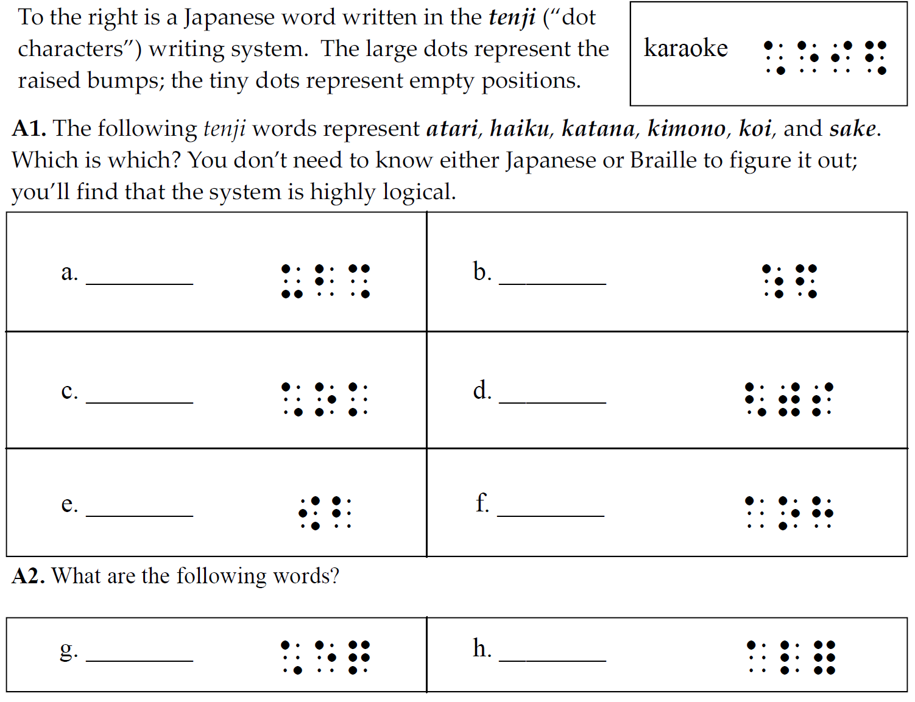
[Tenji Karaoke, by Patrick Littell, NACLO 2009]

Slide 17
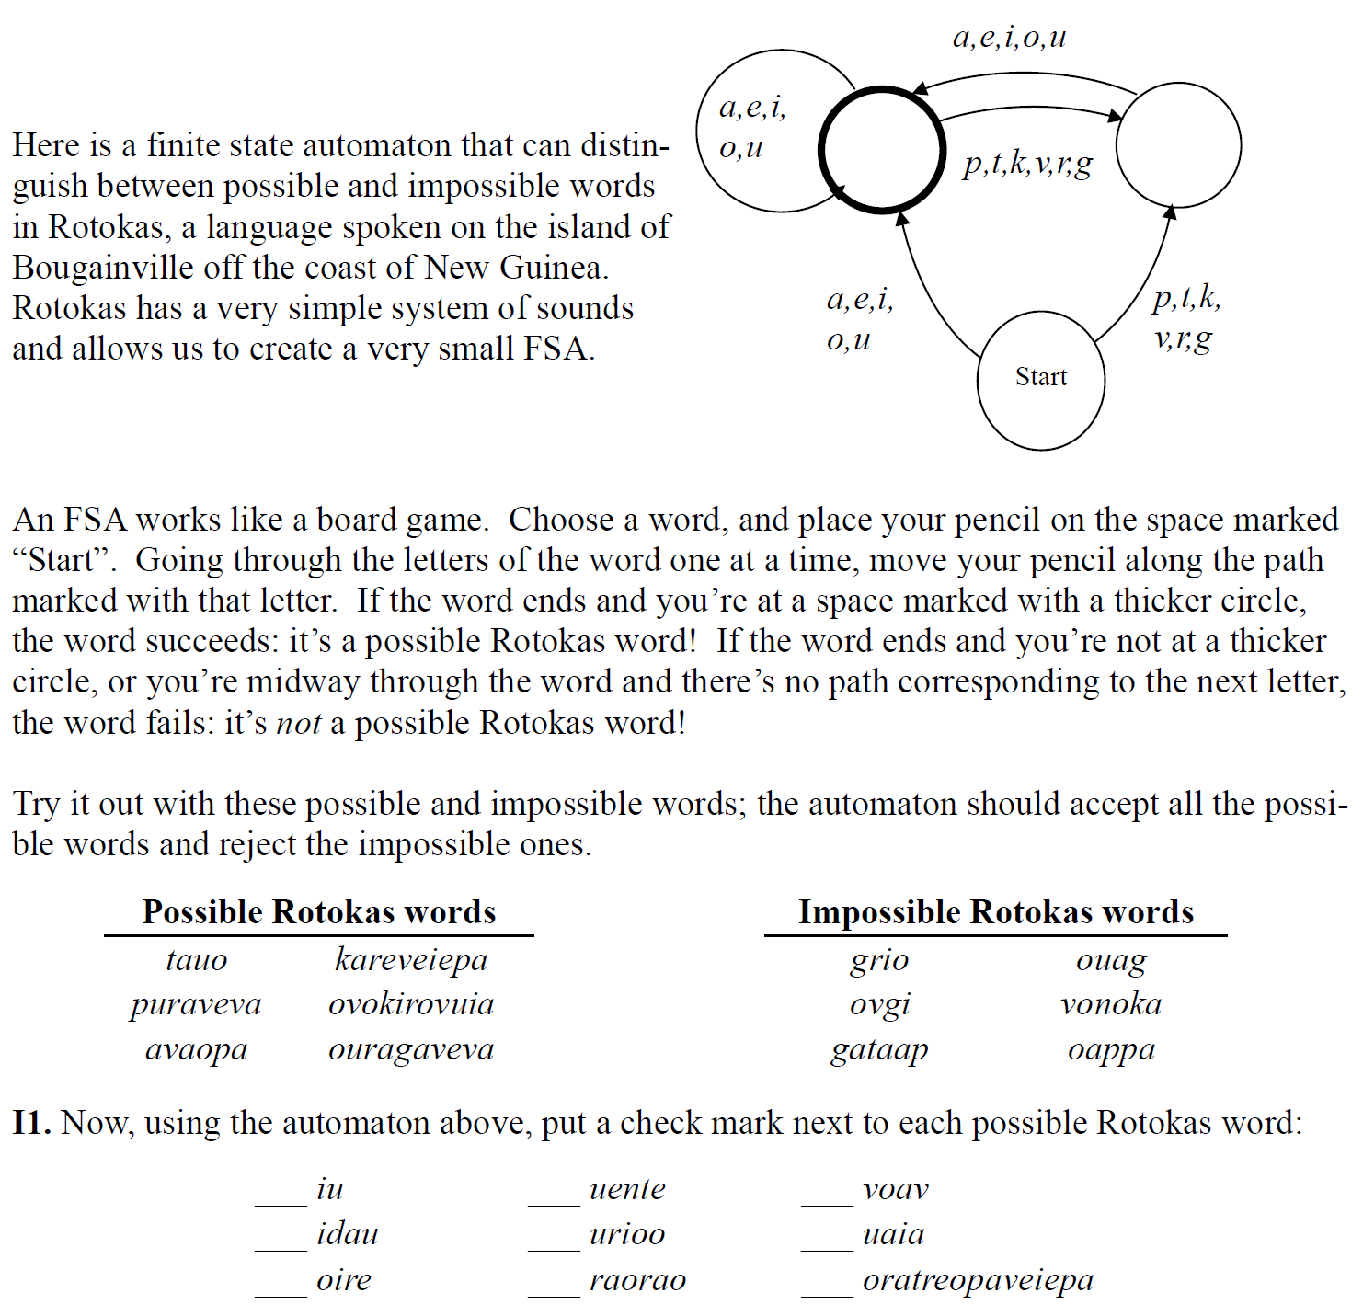
[aw-TOM-uh-tuh, by Patrick Littell, NACLO 2008]

Slide 18
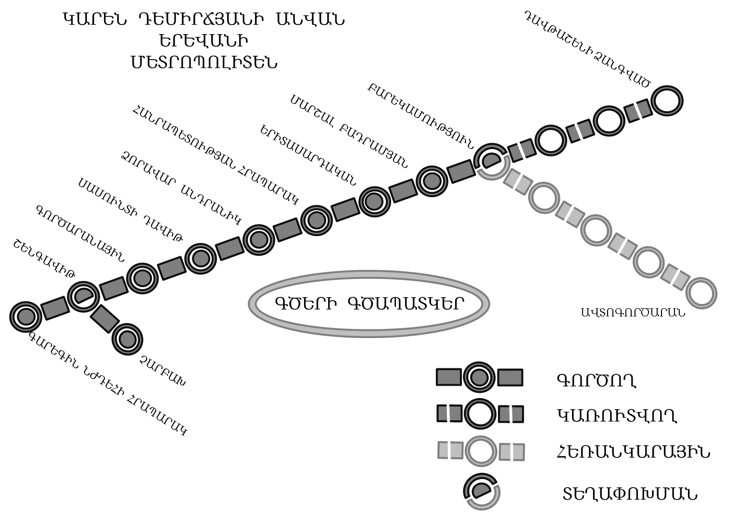
On her visit to Armenia, Millie has gotten lost in Yerevan, the nation’s capital. She is now at the Metropoliten (subway) station named Shengavit, but her friends are waiting for her at the station named Barekamutyun. Can you help Millie meet up with her friends?
1. Assuming Millie takes a train in the right direction,
which will be the first stop after Shengavit?
Note that all names of stations listed below appear on the map.
a. Gortsaranayin
b. Zoravar Andranik
c. Charbakh
d. Garegin Njdehi Hraparak
e. none of the above
2. After boarding at Shengavit, how many stops will it take Millie to get to Barekamutyun (don’t include Shengavit itself in the number of stops)?
[Lost in Yerevan, by Dragomir Radev, NACLO 2010]

Slide 19
NACLO: Computational Problems
http://www.nacloweb.org/resources/problems/2016/N2016-B.pdf
http://www.nacloweb.org/resources/problems/2016/N2016-H.pdf
http://www.nacloweb.org/resources/problems/2016/N2016-K.pdf
http://www.nacloweb.org/resources/problems/2016/N2016-P.pdf
http://www.nacloweb.org/resources/problems/2015/N2015-E.pdf
http://www.nacloweb.org/resources/problems/2015/N2015-K.pdf
http://www.nacloweb.org/resources/problems/2015/N2015-M.pdf
http://www.nacloweb.org/resources/problems/2015/N2015-P.pdf
http://www.nacloweb.org/resources/problems/2015/N2015-G.pdf
http://www.nacloweb.org/resources/problems/2014/N2014-O.pdf
http://www.nacloweb.org/resources/problems/2014/N2014-P.pdf
http://www.nacloweb.org/resources/problems/2014/N2014-C.pdf
http://www.nacloweb.org/resources/problems/2014/N2014-J.pdf
http://www.nacloweb.org/resources/problems/2014/N2014-H.pdf
http://www.nacloweb.org/resources/problems/2014/N2014-L.pdf
http://www.nacloweb.org/resources/problems/2013/N2013-C.pdf
http://www.nacloweb.org/resources/problems/2013/N2013-F.pdf
http://www.nacloweb.org/resources/problems/2013/N2013-H.pdf
http://www.nacloweb.org/resources/problems/2013/N2013-L.pdf
http://www.nacloweb.org/resources/problems/2012/N2012-C.pdf
http://www.nacloweb.org/resources/problems/2013/N2013-N.pdf
http://www.nacloweb.org/resources/problems/2013/N2013-Q.pdf
http://www.nacloweb.org/resources/problems/2012/N2012-K.pdf
http://www.nacloweb.org/resources/problems/2012/N2012-O.pdf
http://www.nacloweb.org/resources/problems/2012/N2012-R.pdf
http://www.nacloweb.org/resources/problems/2011/F.pdf
http://www.nacloweb.org/resources/problems/2011/M.pdf
http://www.nacloweb.org/resources/problems/2010/D.pdf
http://www.nacloweb.org/resources/problems/2010/E.pdf
http://www.nacloweb.org/resources/problems/2010/I.pdf
http://www.nacloweb.org/resources/problems/2010/K.pdf
http://www.nacloweb.org/resources/problems/2009/N2009-E.pdf
http://www.nacloweb.org/resources/problems/2009/N2009-G.pdf
http://www.nacloweb.org/resources/problems/2009/N2009-J.pdf
http://www.nacloweb.org/resources/problems/2009/N2009-M.pdf
http://www.nacloweb.org/resources/problems/2008/N2008-F.pdf
http://www.nacloweb.org/resources/problems/2008/N2008-H.pdf
http://www.nacloweb.org/resources/problems/2008/N2008-I.pdf
http://www.nacloweb.org/resources/problems/2008/N2008-L.pdf
http://www.nacloweb.org/resources/problems/2007/N2007-A.pdf
http://www.nacloweb.org/resources/problems/2007/N2007-H.pdf
http://www.nacloweb.org/resources.php

Slide 20
NLP

